Slide 1

What (under the prevention/relief duty) works in tackling homelessness arising from family/friend evictions?

Slide 2

Main reason for loss of settled accommodation in England, 22/23 (DLUHC)

Slide 3
Notes:
(England) Singificant trigger for h/less application. 2nd main reason for a council owing prevention duty, and main reason for relief duty in 22/23

Slide 4
Universal/ population wide
Targeted/
upstream
Crisis
Emergency
Recovery

Slide 5
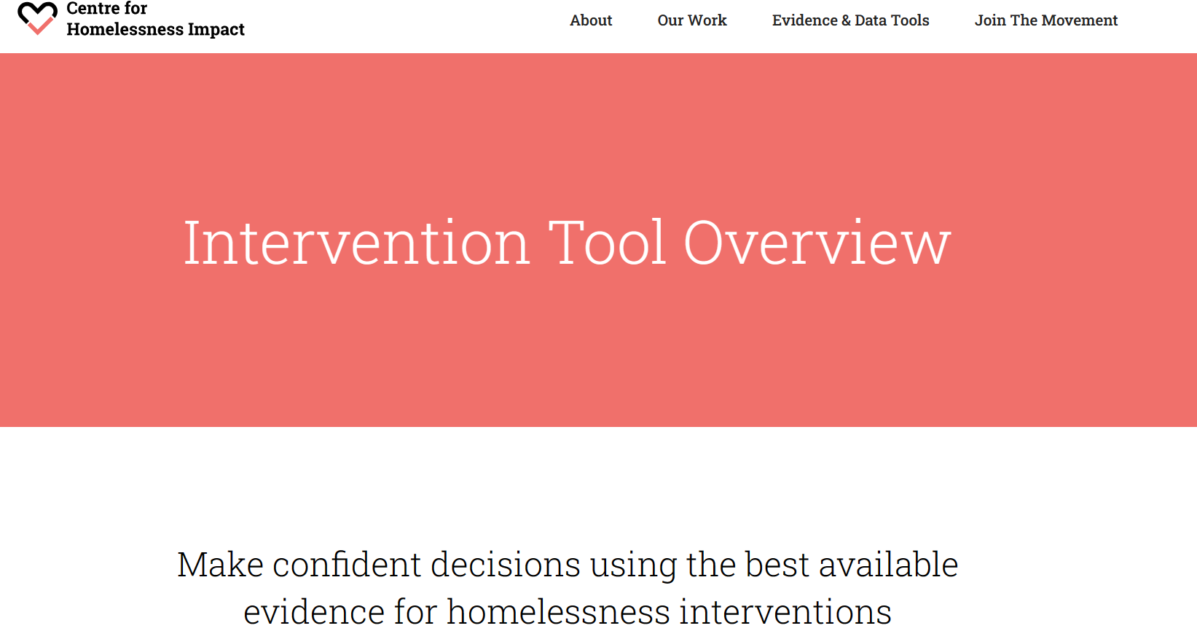
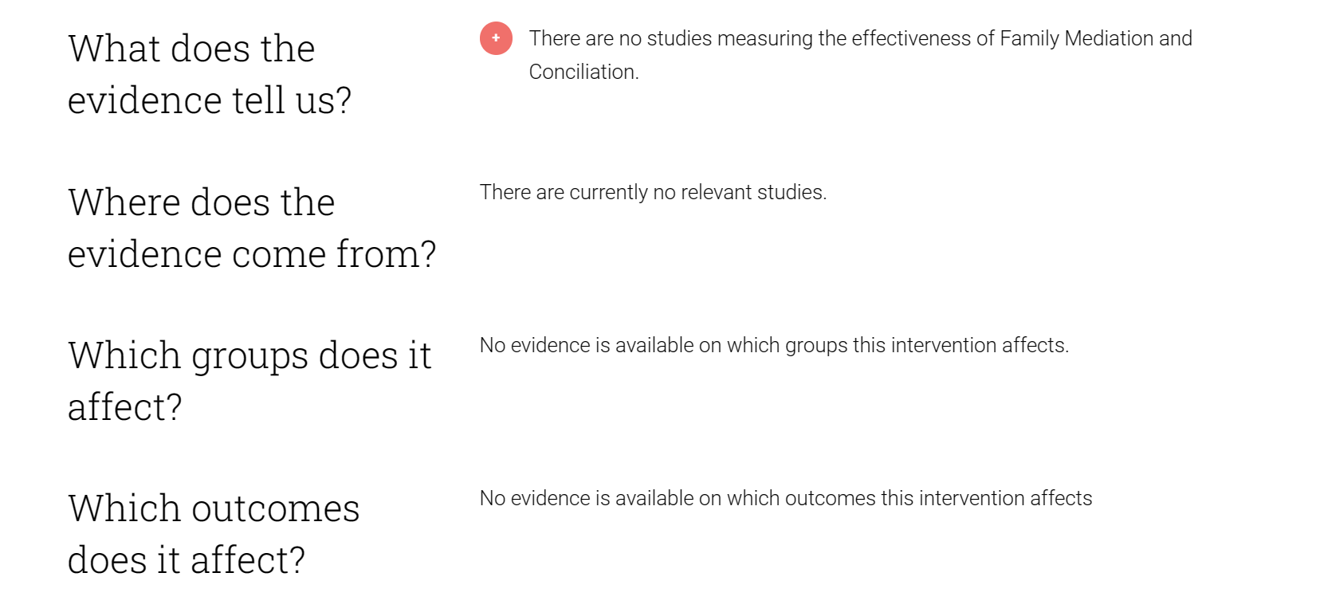
Mediation/conciliation = address issues in the relationship to return to, or remain in the home.

Slide 6
Huge trigger of homeless apps
Main statutory tool in England to deal = HRA/ Homeless Prevention/Relief duty but…
These duties take place at crisis stage, where there is a lack of evidence re effectiveness of interventions. (But worth studying because…
Mediation/conciliation + home visits mooted as an option but
No reliable evidence as to whether this works: no studies have been done.

Slide 7

Field experiment on cases where main reason for loss of accommodation = ‘Family no longer willing/able to accommodate’ + ‘Friends no longer willing/able to accommodate’
Business as usual
Mediation/ conciliation/ home visits

Slide 8
Null hypothesis: Offering mediation/conciliation [or home visits] has no impact on the success of a homeless prevention/relief family/friend eviction case
Alternative hypothesis: Mediation/conciliation[or home visits] prevents/relieves homelessness arising from family/friend evictions.

Slide 9
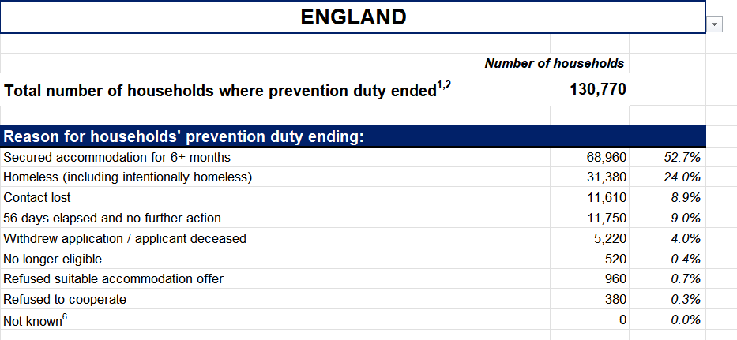
Measurement
Success: Measured by a prevention or relief duty ending with housing being secured for 6months +. (Existing or alternative accommodation)
Tracking: TBC –Marker on Homeless app
Sample size: approx. 100 (3 months)

Slide 10


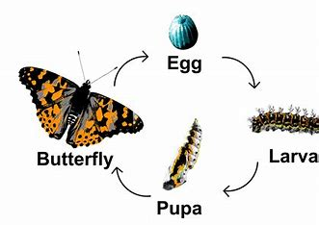




Slide 11
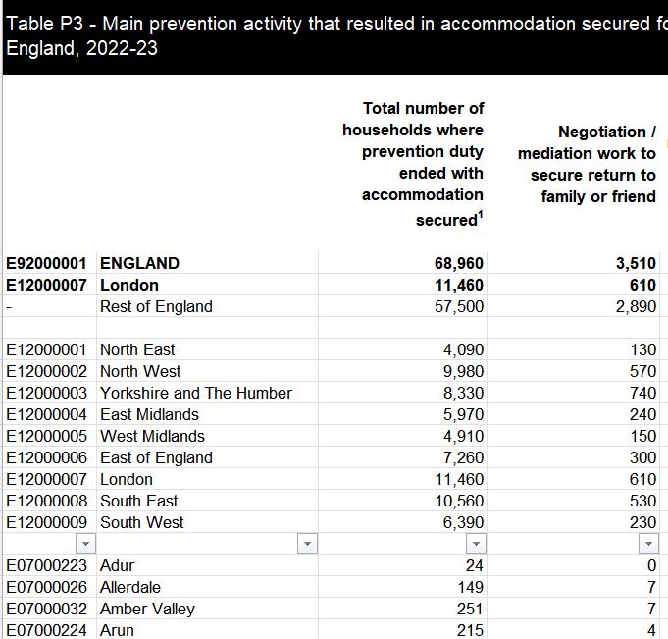
If that’s rubbish…
Seek to ask:
Why are family and friend evictions so high in Southend on Sea compared to other Local Authority Areas?
What are the reasons behind fam/friend evictions in Southend? (sem-structured interviews)
Are a lot of the family/friend eviction cases that we assist under a homeless relief duty (i.e. those that are homeless) cases that we have been unsuccessful helping under the prevention duty? (Quant data analysis)
What should mediation to prevent homelessness look like(to inform approach)? - 3,510 homeless applicants in England had ‘main activity that resulted in accommodation secured for households’ = Negotiation/mediation to secure return to family/friend. Can publicly see which LA’s make up this number
-Could look at both publicly available data and seek a formal request to gov/UK data service (as restricted) to share data, to perform analysis on this, whilst also doing an FOI to the council’s that are offering this, finding out what it looks like/potentially doing some interviews with applicants/officers and other LA’s & build a mode/framework for others to follow based on this if they want to offer this intervention. *will have to do an element of this anyway to build local intervention
Administrative data analysis + semi structured interviews with applicants/officers + possibly survey of LA’s via FOI

